Slide 1
Aloha Critter Club
Our Story

Slide 2
Who Are We?
Join us in our mission to create animal experts that take meaningful action within their community! We are a non-profit organization that helps schools build after-school clubs that focus on social emotional learning (SEL) through a shared love for animals, in an effort to improve animal welfare and build a better community.

Slide 3
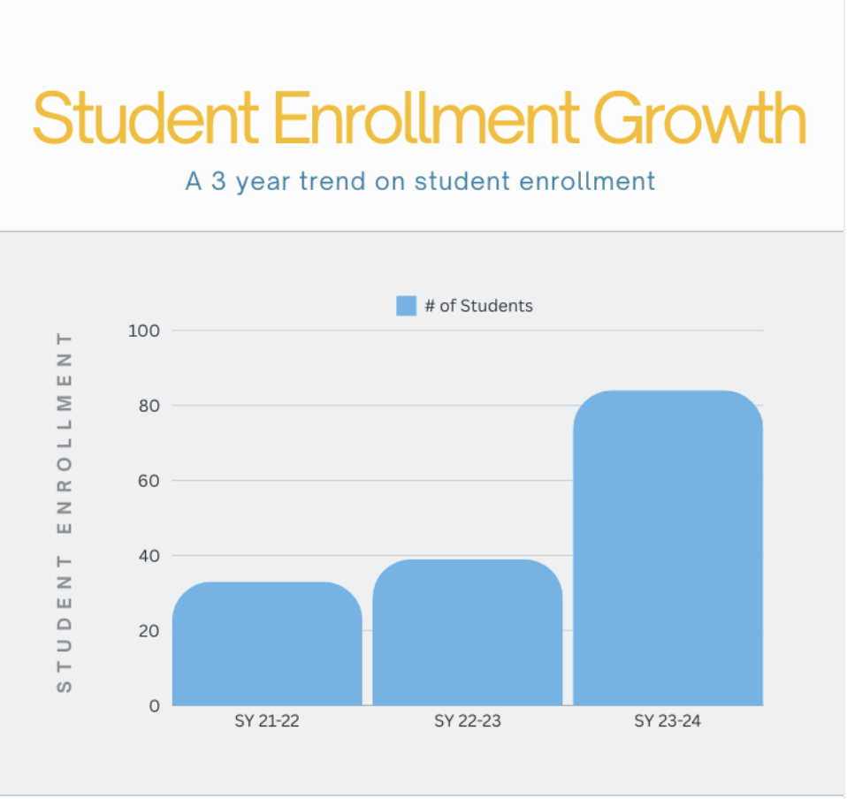

Slide 4
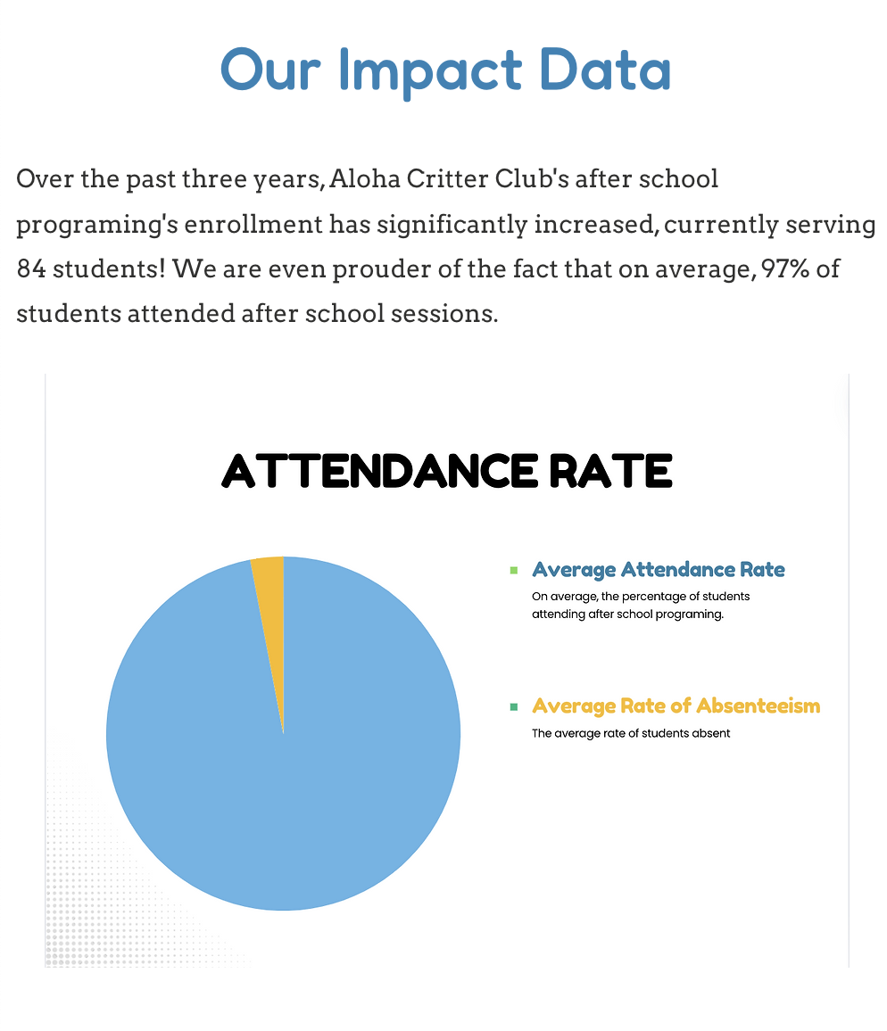

Slide 5
Let's check out what we've done!

Slide 6
Background (share verbally):
We are in the early stages of seeking external funding. Besides some donations, we have not attempted to secure outside funding. But we recognize now that this is the only way for us to expand our impact.

Slide 7
Question 1
I know Hau’oli Mau Loa foundation doesn’t accept unsolicited grant proposals. Based off of our story, do we fit as a potential match with your organization’s strategic direction? Specifically, do we align with the “Hope for Kids” or “First Generation Partners” strategic initiatives?
If so, go to slide 8. Otherwise, skip to slide 9.
Notes:
No potential match at this time.

Slide 8
Question 2
What would be the next steps to securing a grant application? Are there specific impact measurements you are looking for as an organization?

Slide 9
Question 3 (if we aren’t a match)
Thank you so much for still taking the time to listen to our story. I know Tara mentioned that you used to work for Hawai’i Community Foundation. We are applying for the East Hawai’i Fund, and I was wondering if you had any tips on the application. Specifically, if there are particular impact points that they are looking for in their proposals?
E.g.: What type of data tends to be on successful grant proposals?
Notes:
– Include Native Hawaiian Cultural Practices (brochures and other information in Hawaiian language)...field trips with a hawaiian base organization
– How to incorporate families with the things we’re learning
–What is our need? We started ACC because of this…(can tell through the use of storytelling)
–Include “Theory of Change”...if we do this, then this can happen in the future
Impact data:
– # of schools and which specific schools
– What the students have learned and if we changed anything because of their suggestions
– don’t need to include attendance
We should show that we are aware of similar organizations doing what we’re doing (Aloha Ilio, Humane Society…) We don’t want to come across and say that we are the only organization on this island that…
Income Budget
– to identify pending and secured (if all is pending that’s ok)
– East Hawaii Fund will not come back to us if we are asking for 10K and they can only give us 5K.
– Be very specific with the numbers and what we’ll be using it for. Don’t just put it in one sentence, spell it out to them of what we’ll be using it for…so that they have no questions.

Slide 10
Question 4
Do you mind if we ask a quick funding question? From what I understand, typically, East Hawai’i fund works with 5K or 10K proposals. Is it beneficial to ask for $10,000 if that aligns with our budget proposals? And if we ask for $10,000, would they also consider coming back to us if they can’t offer 10K, but can offer 5K, and allow us to adjust our proposal?

